Slide 1
Artificial Intelligence Chapter 1: Introduction to AI

Slide 2
Index
General introduction
History of AI
Introduction to AI
Why AI?
What comprises to AI?
Applications of AI
Advantages & Disadvantages of AI
Types of AI
Agents in AI
Intelligent agent & Rational agent
PEAS representation
Types of AI agent
Agents environment in AI

Slide 3
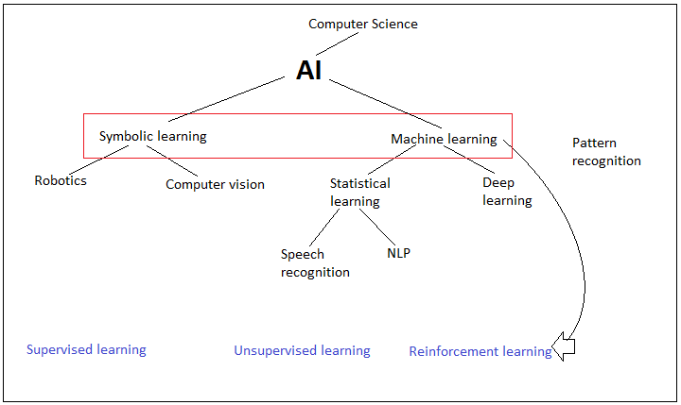
General introduction….

Slide 4
History of AI
Alan Turing, a brilliant mathematician, who broke the Nazi encryption machine Enigma, came up with question, “Can machines think?” in 1950.
In 1956, at a conference held with attendees, who came up with the idea and also the name “Artificial Intelligence”.
This period, the 1950s – 1980s was called “AI Winter”.
In the early 1980s however, the Japanese government started funding was a sudden spike in those as well.
The first AI machine was introduced to the world in 1997; IBM’s Deep Blue became the first computer to beat a chess champion when it defeated Russian grandmaster Garry Kasparov.
And that, was the advent of a massive field called “AI”.

Slide 5
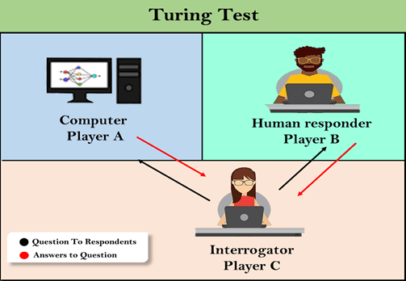
History of AI: Turing test in AI
In 1950, Alan Turing introduced Turing test that the computer can be said to be an intelligent if it can mimic human response under specific conditions.
The Turing test is based on a party game "Imitation game," with some modifications. This game involves three players; Computer, human responder , and the third player is a human Interrogator, who is isolated from other two
players and his job is to find that which player is machine
among two of them.
The conversation between all players is via keyboard and screen
The test result does not depend on each correct answer, but
only how closely its responses like a human answer.
However, no AI program to till date, come close to passing an
undiluted Turing test".

Slide 6
Introduction to AI
Artificial Intelligence is composed of two words Artificial and Intelligence, where Artificial defines "man-made," and intelligence defines "thinking power", hence AI means "a man-made thinking power.“
Intelligence : ability to learn and solve the problems.
If the computers can, somehow, solve real-world problems, by improving on their own from the past experiences, they would be called “intelligent”.
AI systems are more generic, have the ability to “think” and are more flexible.
So, we can define AI as:
"It is a branch of computer science by which we can create intelligent machines which can behave like a human, think like humans, and able to make decisions.“
With Artificial Intelligence you do not need to pre-program a machine to do some work, despite that you can create a machine with programmed algorithms which can work with own intelligence, and that is the awesomeness of AI.

Slide 7
Why AI ?
With the help of AI, you can create such software or devices which can solve real-world problems very easily and with accuracy such as health issues, marketing, traffic issues, etc.
With the help of AI, you can create your personal virtual Assistant, such as Cortana, Google Assistant, Siri, etc.
With the help of AI, you can build such Robots which can work in an environment where survival of humans can be at risk.
AI opens a path for other new technologies, new devices, and new Opportunities.

Slide 8
What comprises to AI ?
To create the AI first we should know that how intelligence is composed,
Intelligence
Knowledge
Experience

Slide 9
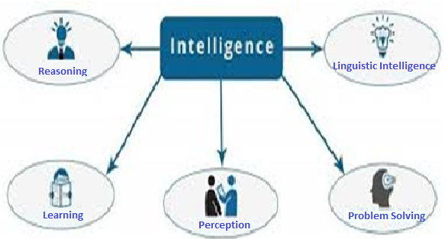
Intelligence composed of…

Slide 10
Intelligence composed of…
Reasoning:
act of deriving a conclusion from certain premises using a given methodology
Reasoning is process of thinking; logically arguing drawing inferences
When system is required to do something, that it has not been explicitly told how to do, it must reason. It must figure out what it needs to know from what it already knows
Learning: improves the knowledge of an AI program by making observations about its environment.

Slide 11
Intelligence composed of…
Problem Solving:
refers to a state where we wish to reach to a definite goal from a present state or condition.
a problem-solving is a part of artificial intelligence which encompasses a number of techniques such as algorithms, heuristics to solve a problem
Perception:
Perception is a process to interpret, acquire, select and then organize the sensory information that is captured from the real world.

Slide 12
Intelligence composed of…
According to the received information, action is taken by interacting with the environment to manipulate and navigate the objects.
Linguistic Intelligence:
deals with individuals' ability to understand both spoken and written language, as well as their ability to speak and write themselves.

Slide 13
Applications of AI
Natural Language Processing, Gaming, Speech Recognition, Vision Systems, Healthcare, Automotive etc.
autonomous vehicles (such as drones and self-driving cars)
medical diagnosis
proving mathematical theorems
playing games (such as Chess or Go)
search engines (such as Google search)
virtual assistants (such as Siri)
image recognition in photographs
spam filtering
prediction of judicial decisions and targeted online advertisements

Slide 14
Advantages of AI
High Accuracy with less errors
High-Speed
High reliability
Useful for risky areas
Digital Assistant
Useful as a public utility

Slide 15
Disadvantages of AI
High Cost
Can't think out of the box
No feelings and emotions
Increase dependency on machines
No Original Creativity

Slide 16
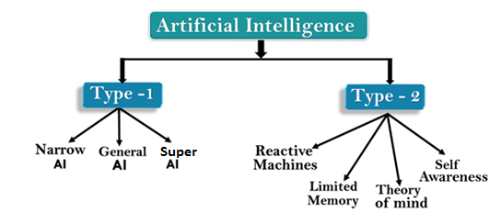
Types of AI
Artificial Intelligence can be divided in various types, there are mainly two types of main categorization which are based on capabilities and based on functionality of AI.

Slide 17
AI Type-I: Based on capabilities
Narrow AI:
Narrow AI is a type of AI which is able to perform a dedicated task with intelligence. The most common and currently available AI is Narrow AI in the world of Artificial Intelligence.
Narrow AI cannot perform beyond its field or limitations, as it is only trained for one specific task. Hence it is also termed as weak AI. Narrow AI can fail in unpredictable ways if it goes beyond its limits.

Slide 18

AI Type-I: Based on capabilities
General AI:
General AI is a type of intelligence which could perform any intellectual task with efficiency like a human.
The idea behind the general AI to make such a system which could be smarter and think like a human by its own. Also known as strong AI.
Currently, there is no such system exist which could come under general AI and can perform any task as perfect as a human.

Slide 19

AI Type-I: Based on capabilities
Super AI:
Super AI is a level of Intelligence of systems at which machines could surpass human intelligence, and can perform any task better than human with cognitive properties. It is an outcome of general AI.
Some key characteristics of super AI include capability include the ability to think, to reason, solve the puzzle, make judgments, plan, learn, and communicate by its own.
Super AI is still a hypothetical concept of Artificial Intelligence.

Slide 20
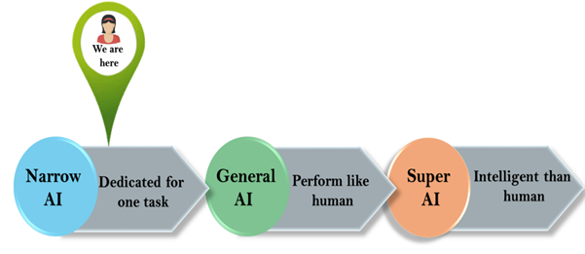
AI Type-I: Based on capabilities

Slide 21

AI Type-II: Based on functionalities
Reactive Machines:
Purely reactive machines are the most basic types of Artificial Intelligence.
Such AI systems do not store memories or past experiences for future actions.
These machines only focus on current scenarios and react on it as per possible best action.
IBM's Deep Blue system is an example of reactive machines.

Slide 22
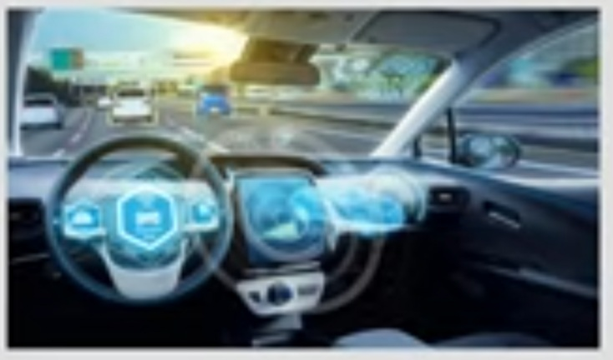
AI Type-II: Based on functionalities
Limited Memory:
Limited memory machines can store past experiences or some data for a short period of time.
These machines can use stored data for a limited time period only.
Self-driving cars are one of the best examples of Limited Memory systems.

Slide 23

AI Type-II: Based on functionalities
Theory of Mind:
Theory of Mind AI should understand the human emotions, people, beliefs, and be able to interact socially like humans.
This type of AI machines are still not developed, but researchers are making lots of efforts and improvement for developing such AI machines.

Slide 24

AI Type-II: Based on functionalities
Self-Awareness:
Self-awareness AI is the future of Artificial Intelligence. These machines will be super intelligent, and will have their own consciousness, sentiments, and self-awareness.
These machines will be smarter than human mind.
Self-Awareness AI does not exist in reality still and it is a hypothetical concept.

Slide 25
Agents in AI
An agent can be anything that perceive its environment through sensors and act upon that environment through actuators. An Agent runs in the cycle of perceiving, thinking, and acting.
An agent can be:
Human-Agent
Robotic Agent
Software Agent

Slide 26
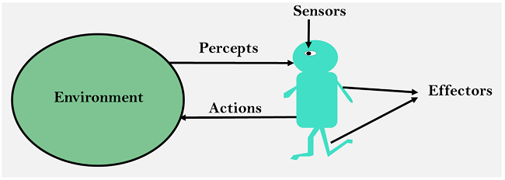
Agents in AI
Sensor: Sensor is a device which detects the change in the environment and sends the information to other electronic devices. An agent observes its environment through sensors.
Actuators: Actuators are the component of machines that converts energy into motion. The actuators are only responsible for moving and controlling a system. An actuator can be an electric motor, gears, rails, etc.
Effectors: Effectors are the devices which affect the environment. Effectors can be legs, wheels, arms, fingers, wings, fins, and display screen.

Slide 27
Intelligent agent
An intelligent agent is an autonomous entity which act upon an environment using sensors and actuators for achieving goals. An intelligent agent may learn from the environment to achieve their goals.
Following are the main four rules for an AI agent:
Rule 1: An AI agent must have the ability to perceive the environment.
Rule 2: The observation must be used to make decisions.
Rule 3: Decision should result in an action.
Rule 4: The action taken by an AI agent must be a rational action.

Slide 28
Rationality
Rationality can be judged on the basis of following points:
Performance measure which defines the success criterion.
Agent prior knowledge of its environment.
Best possible actions that an agent can perform.
The sequence of precepts.

Slide 29
Rational agent
Rational agents in AI are very similar to intelligent agents.
A rational agent is an agent which has clear preference, models uncertainty, and acts in a way to maximize its performance measure with all possible actions.
A rational agent is said to perform the right things. AI is about creating rational agents to use for game theory and decision theory for various real-world scenarios.
For an AI agent, the rational action is most important because in AI reinforcement learning algorithm, for each best possible action, agent gets the positive reward and for each wrong action, an agent gets a negative reward.

Slide 30
Structure of AI agent
The task of AI is to design an agent program which implements the agent function. The structure of an intelligent agent is a combination of architecture and agent program. It can be viewed as:
Agent = Architecture + Agent program
Architecture: Architecture is machinery that an AI agent executes on.
Agent program: Agent program is an implementation of agent function. An agent program executes on the physical architecture to produce function f.
Agent Function: Agent function is used to map a percept to an action.

Slide 31
PEAS representation
PEAS is a type of model on which an AI agent works upon. When we define an AI agent, then we can group its properties under PEAS representation model. It is made up of four words:
P: Performance measure
E: Environment
A: Actuators
S: Sensors
Here performance measure is the objective for the success of an agent's behaviour.

Slide 32
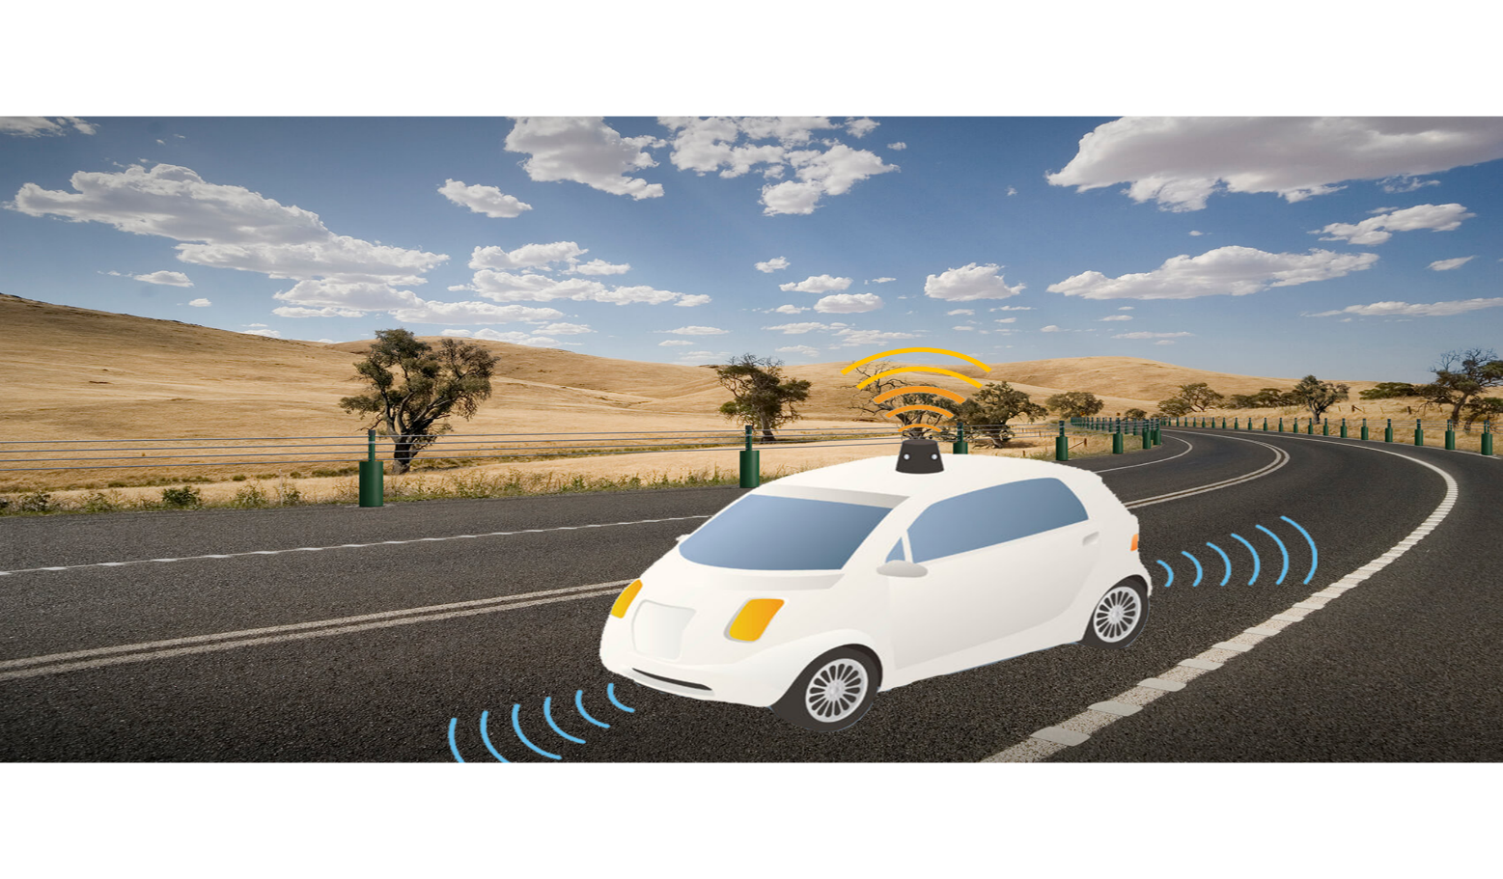
PEAS for self driving car

Slide 33
PEAS for self driving car
Performance: Safety, time, legal drive, comfort
Environment: Roads, other vehicles, road signs, pedestrian
Actuators: Steering, accelerator, brake, signal, horn
Sensors: Camera, GPS, speedometer, odometer, accelerometer, sonar.
PEAS representation for vacuum cleaner, medical diagnose, part-picking robot

Slide 34
Agents environment in AI
An environment is everything in the world which surrounds the agent, but it is not a part of an agent itself.
An environment can have various features from the point of view of an agent:
Fully observable vs Partially Observable
Static vs Dynamic
Discrete vs Continuous
Deterministic vs Stochastic
Single-agent vs Multi-agent
Episodic vs sequential
Known vs Unknown
Accessible vs Inaccessible

Slide 35
Agents environment in AI
Fully observable vs Partially Observable:
If an agent sensor can sense or access the complete state of an environment at each point of time then it is a fully observable environment, else it is partially observable.
A fully observable environment is easy as there is no need to maintain the internal state to keep track history of the world.
An agent with no sensors in all environments then such an environment is called as unobservable.

Slide 36
Agents environment in AI
Deterministic vs Stochastic:
If an agent's current state and selected action can completely determine the next state of the environment, then such environment is called a deterministic environment.
A stochastic environment is random in nature and cannot be determined completely by an agent.
In a deterministic, fully observable environment, agent does not need to worry about uncertainty.

Slide 37
Agents environment in AI
Episodic vs Sequential:
In an episodic environment, there is a series of one-shot actions, and only the current percept is required for the action.
However, in Sequential environment, an agent requires memory of past actions to determine the next best actions.
Single-agent vs Multi-agent
If only one agent is involved in an environment, and operating by itself then such an environment is called single agent environment.
However, if multiple agents are operating in an environment, then such an environment is called a multi-agent environment.

Slide 38
Agents environment in AI
Static vs Dynamic:
If the environment can change itself while an agent is deliberating then such environment is called a dynamic environment else it is called a static environment.
Static environments are easy to deal because an agent does not need to continue looking at the world while deciding for an action.
However for dynamic environment, agents need to keep looking at the world at each action.
Taxi driving is an example of a dynamic environment whereas Crossword puzzles are an example of a static environment.

Slide 39
Agents environment in AI
Discrete vs Continuous:
If in an environment there are a finite number of precepts and actions that can be performed within it, then such an environment is called a discrete environment else it is called continuous environment.
A chess game comes under discrete environment as there is a finite number of moves that can be performed.
Known vs Unknown
In a known environment, the results for all actions are known to the agent. While in unknown environment, agent needs to learn how it works in order to perform an action.
It is quite possible that a known environment to be partially observable and an Unknown environment to be fully observable.

Slide 40
Agents environment in AI
Accessible vs Inaccessible
If an agent can obtain complete and accurate information about the state's environment, then such an environment is called an accessible environment else it is called inaccessible.
An empty room whose state can be defined by its temperature is an example of an accessible environment.
Information about an event on earth is an example of Inaccessible environment.

Slide 41
Types of AI agents
Agents can be grouped into five classes based on their degree of perceived intelligence and capability.
These are given below:
Simple Reflex Agent
Model-based reflex agent
Goal-based agents
Utility-based agent
Learning agent

Slide 42
Types of AI agents
Simple Reflex agent:
The Simple reflex agents are the simplest agents. These agents take decisions on the basis of the current precepts and ignore the rest of the percept history.
These agents only succeed in the fully observable environment.
The Simple reflex agent does not consider any part of precepts history during their decision and action process.
The Simple reflex agent works on Condition-action rule, which means it maps the current state to action. Such as a Room Cleaner agent, it works only if there is dirt in the room.

Slide 43
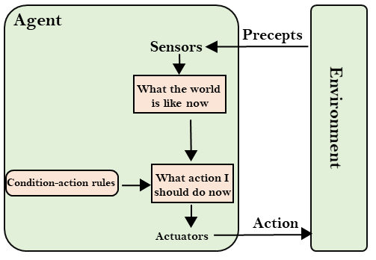
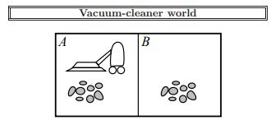
Types of AI agents: Simple reflex agent
if floor_status = dirty then return clean
else if location = A then return Right
else if location = B then return Left
if floor_status = dirty then return clean

Slide 44
Types of AI agents
Model-based reflex agent
The Model-based agent can work in a partially observable environment, and track the situation.
A model-based agent has two important factors: Model and Internal State
These agents have the model, "which is knowledge of the world" and based on the model they perform actions.
Updating the agent state requires information about:
How the world evolves
How the agent's action affects the world.

Slide 45
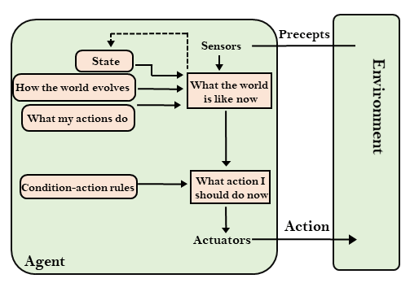
Types of AI agents: Model based reflex agent

Slide 46
Types of AI agent
Goal-based agents
The knowledge of the current state environment is not always sufficient to decide for an agent to what to do.
The agent needs to know its goal which describes desirable situations.
Goal-based agents expand the capabilities of the model-based agent by having the "goal" information.
They choose an action, so that they can achieve the goal.
These agents may have to consider a long sequence of possible actions before deciding whether the goal is achieved or not. Such considerations of different scenario are called searching and planning, which makes an agent proactive.

Slide 47
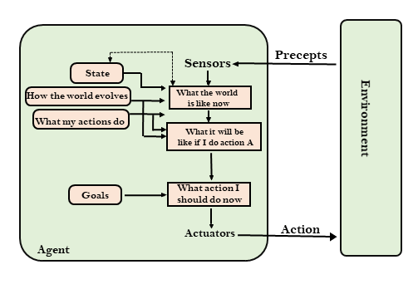
Types of AI agents: Goal based agent

Slide 48
Types of AI agents
Utility-based agents
These agents are similar to the goal-based agent but provide an extra component of utility measurement which makes them different by providing a measure of success at a given state.
Utility-based agent act based not only goals but also the best way to achieve the goal.
The Utility-based agent is useful when there are multiple possible alternatives, and an agent has to choose in order to perform the best action.
The utility function maps each state to a real number to check how efficiently each action achieves the goals.

Slide 49
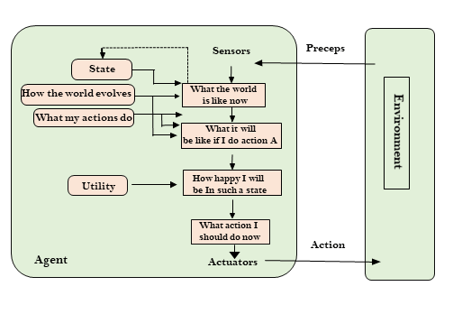
Types of AI agents: Utility based agent

Slide 50
Types of AI agents
Learning Agents
A learning agent in AI is the type of agent which can learn from its past experiences, or it has learning capabilities.
It starts to act with basic knowledge and then able to act and adapt automatically through learning.
A learning agent has mainly four conceptual components, which are:
Critic
Learning element
Performance element
Problem generator
Hence, learning agents are able to learn, analyze performance, and look for new ways to improve the performance.

Slide 51
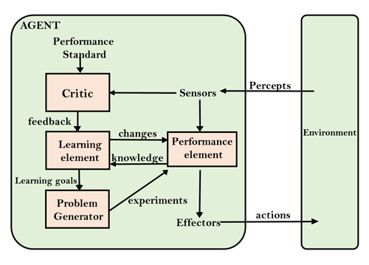
Types of AI agents: Learning agent

